Slide 1
PPCHP2014
Vertex Function of Gluon-Photon Penguin
Swee-Ping Chia
High Impact Research, University of Malaya
50603 Kuala Lumpur, Malaysia
E-Mail: spchia@um.edu.my
8-11 October 2014 NTHU & Fo Guang Shan

Slide 2
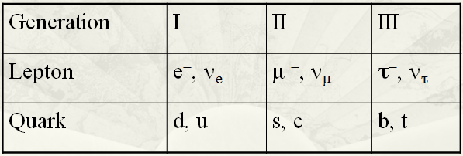
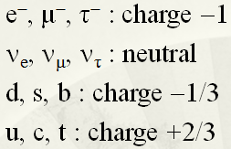
STANDARD MODEL (SM)
Gauge Group: SU(3) × SU(2) × U(1)
SU(3): Strong Interaction - QCD
SU(2) × U(1): Electroweak Interaction - Weinberg-Salam
Three Generations of Quarks and Leptons

Slide 3
UNIFIED THEORY OF WEAK & EM INTERACTION
Weinberg-Salam Theory: SU(2) × U(1) Gauge Group
Higgs Mechanism: Spontaneous Symmetry Breaking (SSB)
Gauge particles after SSB:
W-boson: Massive M_{W} = 80.385(15) GeV
Z-boson: Massive M_{Z} = 91.1876(21) GeV
Photon: Massless
Scalar boson left behind after SSB:
Higgs Boson: Mass MH = 125.9(4) GeV

Slide 4
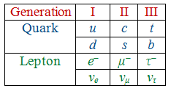
STRONG INTERACTION
Quantum Chromodynamics (QCD): SU(3) Gauge Group
Symmetry exact
Gauge particle
Gluon: Massless
THREE GENERATIONS OF QUARKS
Expt → N_{ν} = 3

Slide 5
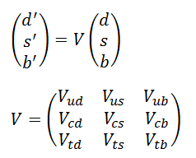
MIXING OF QUARK FLAVOURS
CKM Mixing Matrix
Three mixing angles: θ₁, θ₂, θ₃
One phase: δ
CP Violation

Slide 6
Consequences of Quark Mixing
Flavour-Changing Self-Energy
2. Gluon Penguin
3. Photon Penguin
4. Gluon-Photon Penguin

Slide 7
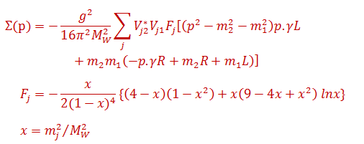
NEUTRAL CHANGE OF QUARK FLAVOURS
Flavour-Changing Self-Energy of Quark
CKM matrix elements come in combination
Internal quark line j = u, c, t.

Slide 8
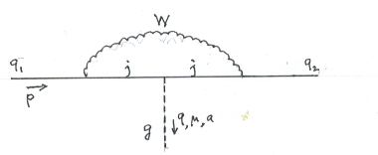
2. Gluon Penguin Vertex
.

Slide 9
3. Photon Penguin Vertex
.

Slide 10
4. Gluon-Photon Penguin Vertex
Three diagrams contributing
The Feynman amplitude for the first diagram, for example, is proportional to the integral
where l is the loop momentum of the internal W line.

Slide 11
is the collection of all the denominator factors.
Introducing Feynman parameters,
where
can be rewritten as

Slide 12
The numerator is given by
Expressing in powers of , can be rewritten as
The integration over can then be evaluated to give
Dimensional regularization is used to control the divergence.
Here, is the Euler constant and with N → 4 so that 1/ε is divergent in the limit.
The overall vertex function is not divergent. The divergent term 1/ε will be cancelled out, giving

Slide 13
Hence
Further assumption: all external quark masses and momenta are small compared to M_{W}. Then
The y and z integrations are easily evaluated. The remaining integration over x can be cast into the form:
which can be easily performed.
The other two Feynman diagrams are similarly calculated.

Slide 14
4. Gluon-Photon Penguin Vertex
.

Slide 15
Ward-Takahashi Identity
Relate Gluon Penguin Vertex to
Flavour-Changing Self-Energy
Relate Photon Penguin Vertex to
Flavour-Changing Self-Energy

Slide 16
Relate Gluon-Photon Penguin Vertex to
Gluon Penguin Vertex and Photon Penguin Vertex

Slide 17
Explicit Expressions for the
Gluon-Photon Penguin Vertex Form Factors
In the expression for the Quark-Gluon-Photon Penguin Vertex, we have retained only terms linear in the external momenta. The other terms involve three to five powers of external momenta, are therefore can be neglected. Assuming that the external momenta are small compared to M_{W}, the vertex function form factors D₁, D₂ and D₃ depend only on the parameter
x = m_{j}²/M_{W}².

Slide 18
Numerical Values
j | m_{j} (GeV) | x_{j} | D₁ | D₂ | D₃
u | 0.0023 | 0.8187E-09 | 0.5458E-09 | −0.2729E-09 | 0.1501E-08
c | 1.275 | 0.2516E-03 | 0.1671E-03 | −0.8364E-04 | 0.4597E-03
t | 173.07 | 0.4635E+01 | 0.4332E+00 | −0.3039E+00 | 0.1211E+01
The magnitude of the vertex function depends not only on the magnitude of D_{i}(x_{j}), i = 1, 2, 3, but on the combination

Slide 19
.
CKM Matrix Elements
V_{ud} = 0.97427(15), V_{us} = 0.22534(65), V_{ub} = 0.00351(15),
V_{cd} = 0.22520(65), V_{cs} = 0.97344(16), V_{cb} = 0.0412(8),
V_{td} = 0.00867(30), V_{ts} = 0.0404(8), V_{tb} = 0.999146(34).
Products of CKM matrix elements:
The products of CKM matrix elements satisfy the unitarity triangle relation
The triangle relation is used to estimate the relative phases of the three λ_{j}’s.

Slide 20
For s → d transition:
λ_{u} = 0.21954
λ_{c} = − 0.21919 + i 0.13570×10⁻³
λ_{t} = − 0.32336×10−3 − i 0.13570×10−3
For b → d transition:
λ_{c} = 0.92782×10⁻²
λ_{t} = − 0.80528×10⁻² + i 0.31926×10⁻²
λ_{u} = − 0.12254×10⁻² − i 0.31926×10⁻²
For b → s transition:
λ_{t} = 0.40365 ×10⁻¹
λ_{c} = − 0.40099×10⁻¹ + i 0.74462×10⁻³
λ_{u} = 0.27119×10⁻³ − i 0.74462×10⁻³

Slide 21
For j = u, the contribution is small for all the three transitions.
Both j = c and j = t contribute in s → d transition, and has magnitude of order 10⁻⁵.
j = t is the dominant contribution in both b → d and
b → s transitions, and is of order 10⁻³.

Slide 22
Conclusion
We have presented the calculation of the vertex function for Gluon-Photon Penguin within the framework of the Standard Model. The vertex function is found finite.
For cases where the external momenta are small compared W-boson mass, the vertex function can be described in terms of 3 form factors, D₁, D₂ and D₃ which depend only on the parameter x = m_{j}²/M_{W}².
The Gluon-Photon Penguin Vertex is related to the Gluon Penguin Vertex and the Photon Penguin Vertex through the Ward-Takahashi Identity.

